Slide 1


Comberton Village College
SEND Information Report 2025-2026
Our commitment to children and young people with SEND
Here at Comberton Village College, we value all pupils equally and firmly believe that every child and young person, including those with SEND, should be supported to succeed and achieve their best.
Our staff work hard to deliver high-quality teaching for all pupils. As an inclusive school community, we aim to ensure that pupils who have SEND benefit from this excellent teaching in mainstream classes.
The four broad areas of SEND which CVC provides support for, are:
Communication and Interaction
Cognition and Learning
Social, emotional and mental health (SEMH)
Sensory and/or Physical needs
My daughter is new to Comberton and I am impressed with how the staff have helped her to settle in and support her mental health and SEN needs.
What is a Special Educational Need? (Code of Practice 2015)
A pupil has SEN where their learning difficulty or disability calls for special educational provision, namely provision different from or additional to that normally available to pupils of the same age. (6.15)
What is a Disability? (Equality Act 2010)
A physical or mental impairment which has a long-term and substantial adverse effect on their ability to carry out normal day-to-day activities’ where ‘long term’ is ‘a year or more’ and ‘substantial’ is ‘more than minor or trivial’.
The Equalities Act states that a person must not be discriminated against due to their disability.
What is the SEND Register?
If a child or young person is receiving a significant intervention which is ‘different from’ and ‘additional to’ their peers, they will be added to the school’s SEND register and parents/carers will be informed of this. This means they will be monitored and supported more closely by the SEND team.
An example of this might be a child with an Education, Health & Care Plan, attached to one of the school’s SEND provisions or on a temporary timetable.

Slide 2
How does the school know if my child needs extra support or has SEND?
We may already be aware that your child or young person has SEND through transition discussions with their previous school. We work hard to liaise with feeder schools for both Year 6/7 and Post-16 transitions, and any relevant information will be shared with us about your child or young person to ensure the right support is put in place here at CVC or CSF.
We may identify that your child or young person needs additional support during their time with us at Comberton. We always plan to identify and meet all learning needs as early as possible.
Subject teachers and pastoral teams, in discussion with the SEND team, closely monitor the progress and attainment of all pupils, including those who have or may have SEND. If it becomes clear that your child or young person is making less than expected progress in line with their peers, this will be discussed with you as a parent/carer to consider what further support is needed and a plan of action agreed. This might be, for example, reasonable adjustments or support strategies in the classroom, a short-term supportive intervention or sign-posting to external services.
Strategy Sheets
All teachers will be informed about your child’s special educational needs, through an individualised strategy sheet. Staff will adapt their approach in and out of lessons, using these strategies, to support your child to fully access the curriculum and school life.
Strategy sheets are coproduced with parents/carers and their child. They highlight your child’s strengths, any barriers to learning and key strategies for support. They are reviewed annually and can be updated if there are significant changes.
How is my child’s learning tracked, assessed and recorded?
All pupils, including those with SEND, are assessed on a regular basis, in accordance with our whole school assessment policy, which can be found on the college website.
Teachers formally assess and review progress at least twice a year. Reports will be emailed to parents/carers twice a year and in addition, there is an annual parents’ evening, when there is an opportunity to discuss progress, attainment and next steps. Pupils with an EHCP will also have an annual review with parents/carers, the SEND team and any other professionals involved in your child’s support.
National guidance for high-quality provision of SEN in schools is based on a step-by-step model known as the Graduated Approach. The Graduated Approach is a cycle of ‘Assess, Plan, Do, Review’ to identify and meet a pupil’s needs through increasingly targeted support. Only one cycle of APDR may be necessary for your child to make the necessary progress, or it might be there are multiple cycles of assessing, coproducing a plan, putting it into practice and then reviewing to see what has been effective. Please see Appendix 1 for further info.
Enhanced Resource Base
We have an Enhanced Resource Base for Autistic pupils. This is called The Cabin. Admissions are managed through the Local Authority. We aim to meet pupils’ individual needs to ensure they have the confidence and skills to realise their ambitions. The Cabin Lead is Jane Hylton.

Slide 3
What support might your child receive?
High quality provision for pupils with SEN is underpinned by high quality teaching and we firmly believe that classroom teaching that is adapted and personalised will meet the individual needs of most pupils and help them progress. Alongside this, excellent pastoral support from tutors and pastoral teams will help your child during their time at Comberton.
For most pupils with SEN, their strategy sheet will be sufficient to signpost to staff the support they need to succeed. E.g. Dyslexia-friendly teaching strategies, a movement break or iPad pass.
Some children and young people do need support that is additional to or different from this and as a college, we will use our best endeavours to make sure that every child with SEN gets the support they need.
This might include:
Additional support with transitions between phases / preparing for adulthood
Interventions in core subjects e.g. Maths or English
Reading and literacy support
Specialist teacher involvement from the LA e.g. HI/VI specialist
Accessibility adaptations or Occupational Therapist support
Attachment to a SEND Provision for those with an EHCP
School Nursing Team and/or Individual Health Care Plan
Support for improving SEMH / targeted pastoral support
Mentoring or counselling services
Referrals to Educational Psychologists or other professionals
Please see Appendix 2 for an extended list of interventions
  What are the different SEND Provisions at Comberton?
  The vast majority of students that have SEN or a diagnosis are supported through OAP (See Waves in Appendix) however if a student has an EHCP or SEN needing Wave 4 involvement we have 4 distinct provisions:
  CABIN (CVC & CSF) an enhanced resource base for those with a diagnosis of autism. Consultation for placement must go through the local authority.
  The Centre for those students who have a specific or moderate learning disability, or a physical, sensory or medical condition
  KS3 / 4 SEMH Support - for those students who have social, emotional and mental health difficulties or behaviour challenges
  Comberton Sixth Form SEND team Students with high levels of identified SEN will have a named contact within one of the support teams, who will keep in regular contact with them, their tutor, subject teachers and home
  All SEND teams work closely with the Local Authority, the Early Help Hub and other health and social care professionals to ensure a joined-up approach to supporting your child or young person. Alongside the LA’s Local Offer, we can also signpost to specialist services or voluntary sector organisations which aim meet young people’s SEN needs and support their families.
"Things I’ve enjoyed this year is having different interventions for my specific needs. This has helped me a lot in my progress with school like helping me go to more lessons supporting me when I need it" - Year 8 Girl

Slide 4
Is the school site accessible?
We are committed to making our school safe, accessible and welcoming to the whole community. We have a range of different facilities to ensure access, including lifts to upper floors, ramps, accessible toilets, a therapy room for physiotherapy, specialist equipment including Tomcat chairs and equipment such as talking scales and calculators, adapted tools and sports equipment. We have installed braille signs on our classroom doors.
Our accessibility plan can be read in the policies section of the school website.
What other information will be useful?
CVC has developed effective working relationships with a wide range of external partners, professionals and agencies. The school works closely with Cambridgeshire County Council and use the Early Help Assessment processes when appropriate to do so.
There are a variety of support services which are available for the parents of pupils with special educational needs. The school will ensure that parents can access appropriate support. Key sources of information and support include:
SENDIASS:
https://www.cambridgeshire.gov.uk/residents/children-and-families/local-offer/local-offer-care-and- family- support/send-informationadvice-and-support-service-sendiass/
Cambridgeshire Local Offer
https://www.cambridgeshire.gov.uk/residents/children- and- families/local-offer/
Early Help Assessment: https://www.cambridgeshire.gov.uk/residents/working-together-children-families- and-adults/how- we- work/children-andfamilies-services/children-and-families-procedures-and-resources/think- family/
IPSEA
Other SEND professionals
Who can I speak to about SEND?
Emily Oakley-Pullen (SENCo) EOakleypullen@combertonvc.org
Laura Peacey (CSF SENCo) LPeacey@combertonvc.org
Jane Hylton - Head of CABIN JHylton@combertonvc.org
For general SEND enquiries, email Com-Send@combertonvc.org
We hope any issues can be resolved through communication with our SEND team, however if you would like speak with a Senior Leader, please do contact our College Principal, Victoria Hearn, through the normal school contact details : com-college@combertonvc.org
Should you need to escalate your concern into a complaint, please refer to the Cam Academy Trust Complaints Policy which can be found on the Cam Academy Trust website.

Slide 5
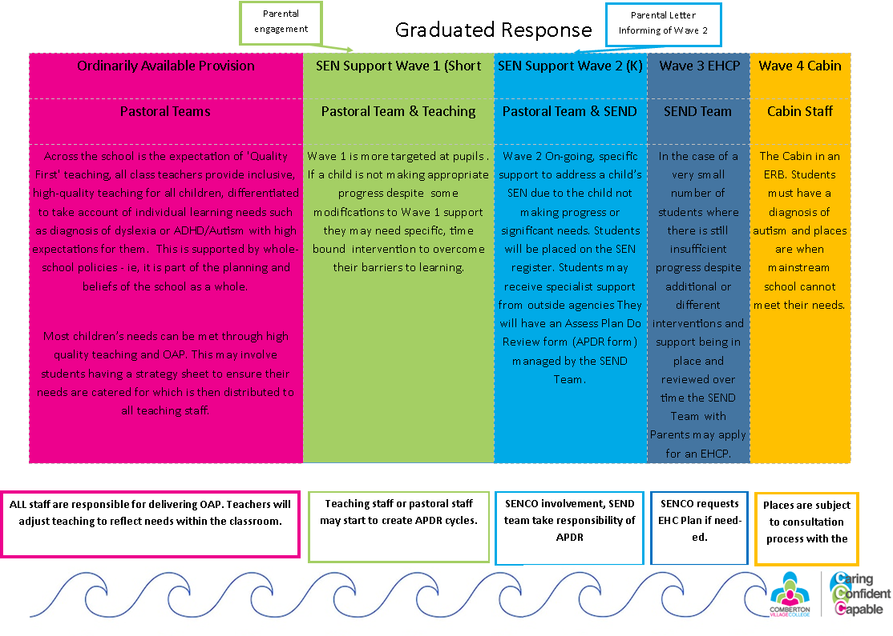
Appendix:

Slide 6
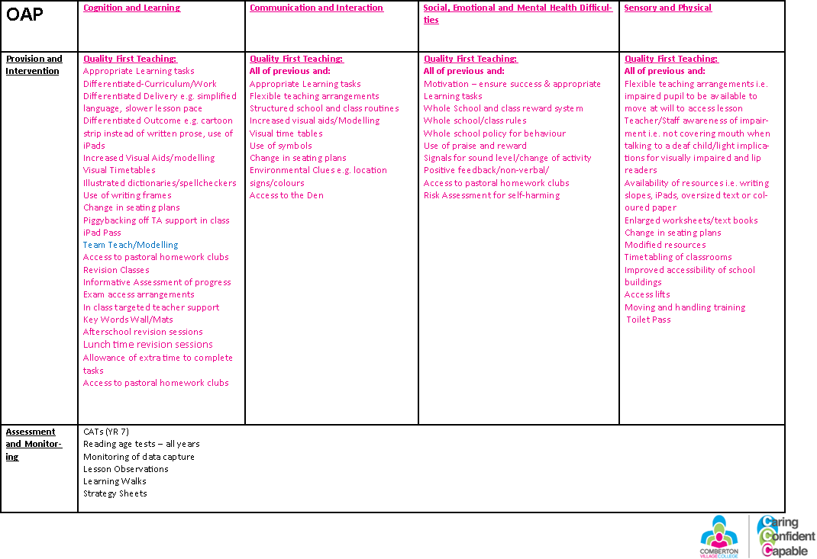

Slide 7
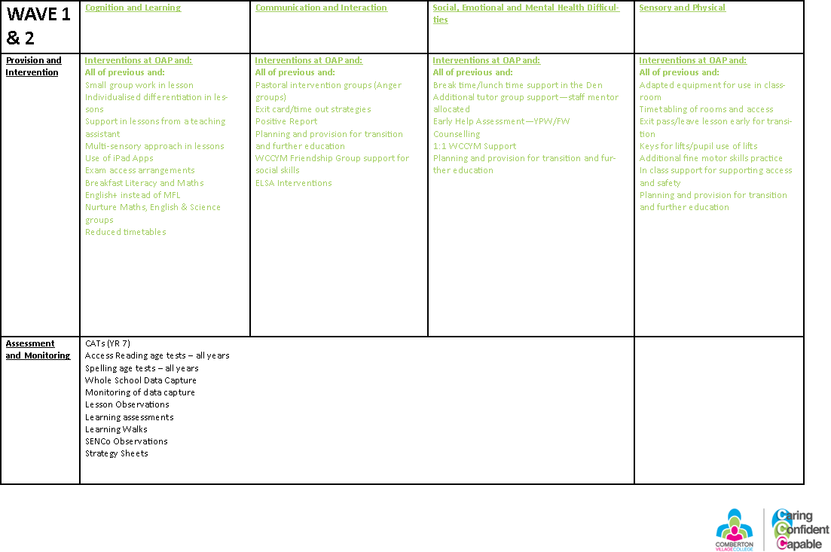

Slide 8
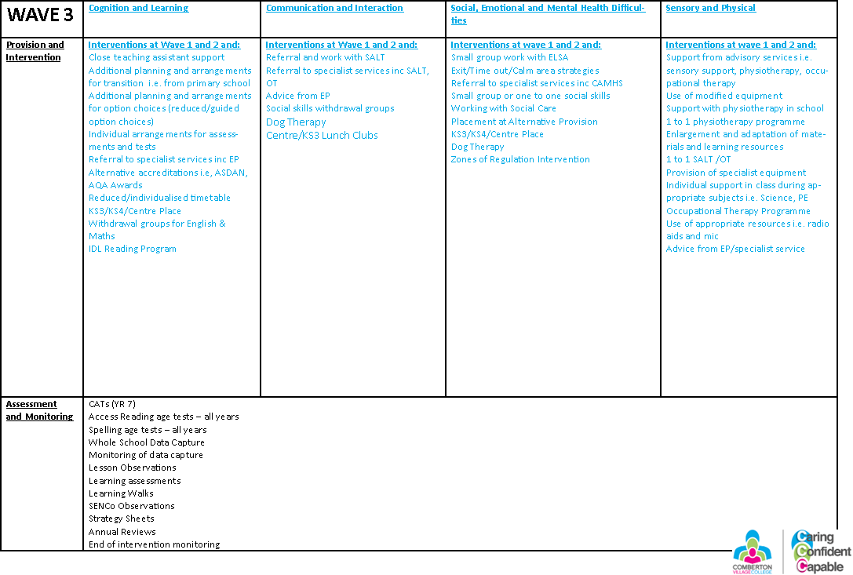

Slide 9
